Slide 1




Benchmarking the Collocation Stand-Alone Library and Toolkit (CSALT)
Steven Hughes*
Jeremy Knittel*
Wendy Shoan*
Youngkwang Kim⁺
Claire Conway^
Darrel Conway^
International Symposium on Space Flight Dynamics
June 8th, 2017
+
^
*

Slide 2
Agenda
Motivation
Optimal Control Problems
CSALT
General Optimal Control Benchmarking Results
Low-Thrust Trajectory Design Benchmarking Results
Summary/Future Work

Slide 3
Motivation
Physical systems which involve time varying control decisions can rarely be solved analytically
Low-thrust spacecraft trajectories cannot be designed using intuition
NASA Goddard’s General Mission Analysis Toolkit (GMAT) has limited capability to solve low-thrust problems
Goals:
Demonstrate that CSALT can solve industry-standard optimal control problems
Demonstrate that CSALT can solve optimal control low-thrust trajectory problems
Compare CSALT execution efficiency to other optimal control software packages

Slide 4
Agenda
Motivation
Optimal Control Problems
CSALT
General Optimal Control Benchmarking Results
Low-Thrust Trajectory Design Benchmarking Results
Summary/Future Work

Slide 5
Optimal Control Problems
Minimize a cost function of the form:
Subject to the following set of ordinary differential equations:
Subject to algebraic path constraints:
Subject to boundary conditions:

Slide 6
Agenda
Motivation
Optimal Control Problems
CSALT
General Optimal Control Benchmarking Results
Low-Thrust Trajectory Design Benchmarking Results
Summary/Future Work

Slide 7
Collocation Stand-Alone Library and TOOLKIT
17000 original source lines of code (SLOC) written in C++
Uses roughly 17000 SLOC from GMAT’s utility code base
Uses Boost C++ library for sparse matrix arithmetic
Uses SNOPT for nonlinear programming optimization
Will be open source released with GMAT eventually (Fall 2017 or Spring 2018)

Slide 8
Current CSALT capability
Multiple collocation transcriptions
Trapezoid
Hermite-Simpson
Lobatto IIIa of order 4,6 and 8
Radau Orthagonal
Multiple cost-function formulations
Mayer
Lagrange
Bolza
Algebraic path and point constraints
Decision vector, cost and constraint scaling
Analytical collocation derivatives with finite differenced user point and path functions
Automatic sparsity pattern determination
Mesh refinement (Radau transcription only)

Slide 9
Agenda
Motivation
Optimal Control Problems
CSALT
General Optimal Control Benchmarking Results
Low-Thrust Trajectory Design Benchmarking Results
Summary/Future Work

Slide 10
High Level Results
Three comparison tools:
SOS - Sparse Optimization Suite written by Dr. John Betts
GPOPS-II – Gauss Pseudospectral OPtimization Software written by Dr. Anil Rao
PSOPT – PseudoSpectral OPTimization written by Dr. Victor Becerra
17 problems selected for objective function comparison
3 problems selected for detailed state and control comparison

Slide 11
Conway Orbit
Classic problem in the literature
Finite-thrust orbit raising
Optimal solutions match perfectly to the scale of the graphics
Maximum relative error in state is better than control
9.841e-6 in state
1.610e-2 in control

Slide 12
Goddard Rocket
Multi-phase problem
Control in optimal solution is discontinuous and has bang-off structure
Control varies in the middle phase to maintain constant terminal velocity
CSALT solution matches very well with reference software in terms of relative error
6.863e-7 in state
2.191e-8 in control

Slide 13
Hypersensitive Problem
Stressing case to the mesh refinement algorithm
Dynamics rapidly change near the boundary conditions, but are nearly constant in between
Relative errors are larger than desirable
4.305e-2 in state
2.911e-1 in control
Believed to be due to interpolation to common discretization times (and away from the collocation points)
This is supported by the relative error between SOS and GPOPS-II (3.54e-1 and 1.037 in state and control respectively)

Slide 14
Agenda
Motivation
Optimal Control Problems
CSALT
General Optimal Control Benchmarking Results
Low-Thrust Trajectory Design Benchmarking Results
Summary/Future Work

Slide 15
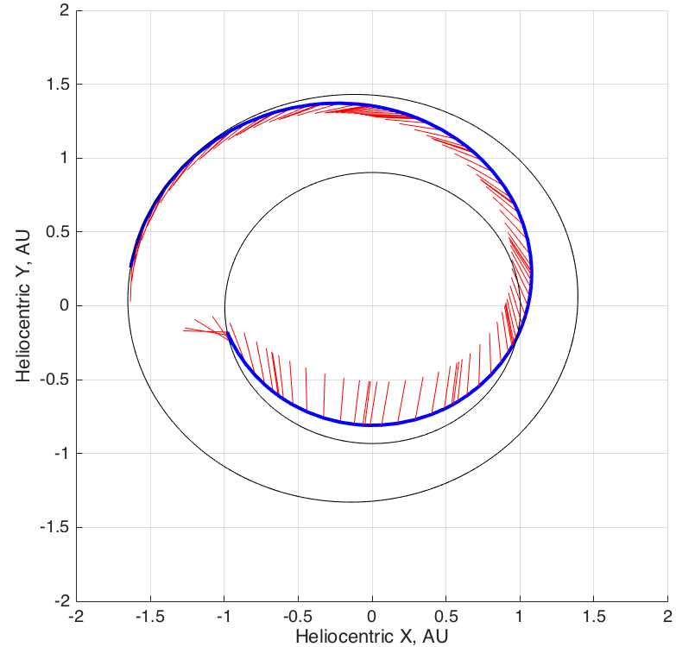
Mars Transfer
CSALT was compared to solutions presented by Horsewood and Dankanich*
Direct transfer from Earth to Mars using 2 ion engines
Qualitatively identical solutions were found using all 3 software tools
The final solutions all match to the expected margin of error of the modeling techniques
*

Slide 16
Dawn
CSALT was compared to solutions presented by Horsewood and Dankanich*
Repeat of the Dawn mission
Earth to Mars low-thrust transfer
Mars flyby
Rendezvous with Vesta
Low-thrust transfer to Ceres
CSALT found a qualitatively improved solution compared to the other two tools
At a cost of ~220 days of additional flight time, 160 extra kg of dry mass could be delivered to Ceres using less propellant

Slide 17
Agenda
Motivation
Optimal Control Problems
CSALT
General Optimal Control Benchmarking Results
Low-Thrust Trajectory Design Benchmarking Results
Summary/Future Work

Slide 18
Summary and Future WOrk
CSALT is a mature software package capable of solving a variety of optimization problems with high accuracy
CSALT has been successfully benchmarked against industry standard tools in both general engineering problems and for the solution of low-thrust trajectories
Future Work
Static and integral decision parameters and integral constraints
Second derivatives of the collocation
Improve performance
Full integration into GMAT

